Slide 1

How-to Video Here:
https://esri.box.com/v/DevSummit2019-HowTo

Slide 2
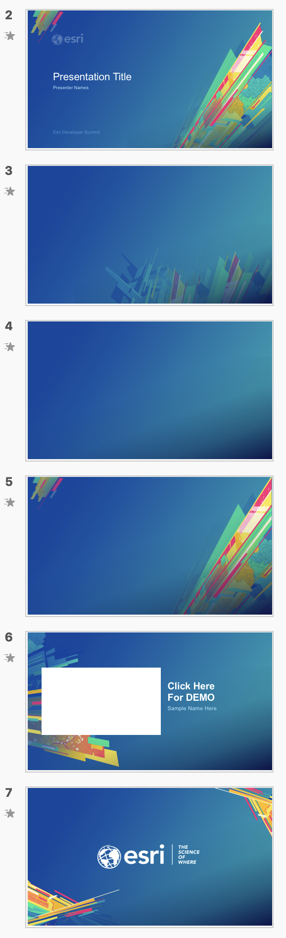
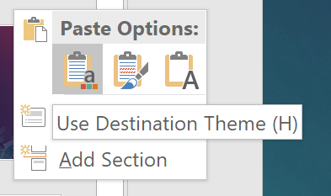
How to apply this template to existing slides
Which background to use?
Title
Open your previous presentation.
Copy all relevant slides from previous presentation to this template. Paste using Destination Theme.
Going slide by slide, copy the Standard Background image of your choice.
Paste and send to back. Windows shortcut: Ctrl+Shift+[
Delete any remaining pieces left from the old background.
For other backgrounds (Title, Section Divider, Demo Intro, and Walkaway) use the provided slides in this template.
Check your fonts. The default font is Arial to maintain consistency across the enterprise. If you used Avenir previously, consider switching to Arial to avoid unknown font substitution by other users. Instructions for changing font themes.
Why not use PowerPoint’s template features?
Standard Background Suitable for Less Content
Standard Background Suitable for More Content
Section Divider
Demo Intro
—
Use behind Images
Walkaway
Notes:
G243257 DevSummit 2019 Template for Esri staff

Slide 3


Coding for Accessibility
Nick Wisehart
2019 ESRI DEVELOPER SUMMIT
Palm Springs, CA
Notes:
G243257 DevSummit 2019 Template for Esri staff

Slide 4

5 Tips for Accessible Apps
Semantic HTML Markup
ARIA
Alternative Navigation
Sight & Sound
Helpful Tools

Slide 5
Semantic HTML5 Markup
Correct heading structure
<button></button> for click events
Landmarks
Header
Footer
Nav
Main
Aside
Role attributes
Title & Alt tags
Notes:
Header Structure
Using proper tags

Slide 6
ARIA (Accessible Rich Internet Applications)
ARIA roles and landmarks should be used in conjunction with semantic HTML5 to convey page structure.
Roles & Landmarks
Search
Navigation (<nav>)
Button (<button>)
Application (custom keyboard interface)
Aria-label is useful when there are two elements with the same role
Notes:
ARIA roles and landmarks can be used in conjunction with semantic HTML5 to convey structure to a page. Most roles and landmarks are now implemented as element tags in HTML5.

Slide 7

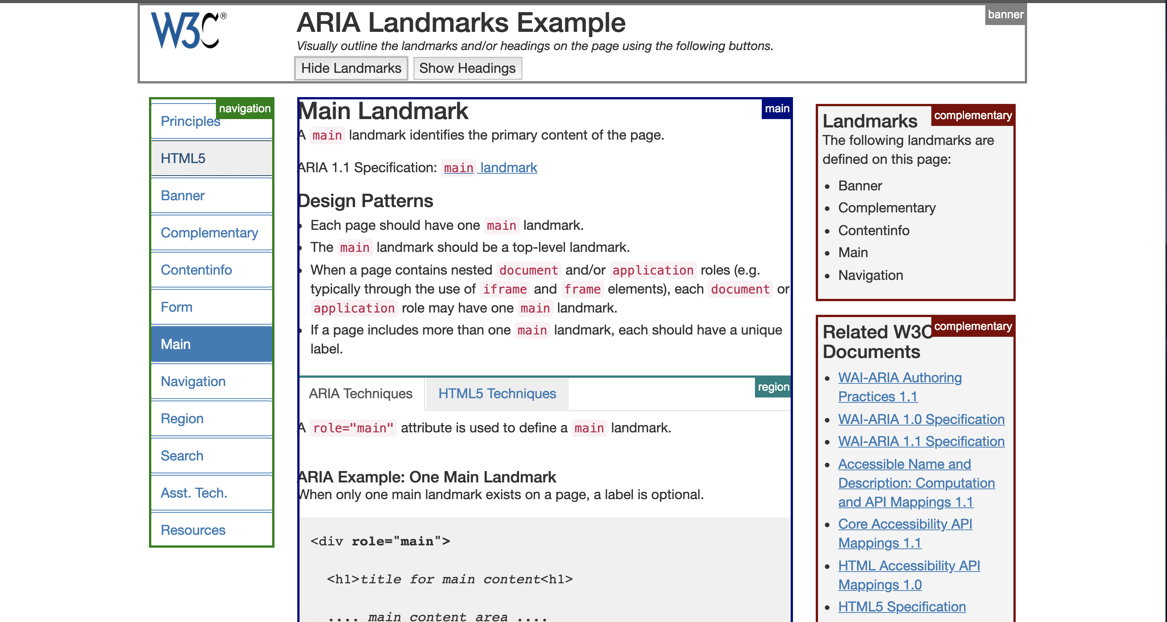
ARIA Demo
Roles & Landmarks
Notes:
Demo the A11y Map

Slide 8
Alternative Navigation
Navigating with the mouse
Click events
Scroll
Hover indicators
Navigating with just the keyboard
Tab order
Focus indicators
Access keys
Event triggers
Notes:
Click vs Tab
Access Keys (esc, 1-10, etc)
Focus indicators (instead of just using hover)
Trigger click evetns with enter on focus

Slide 9
Sight & Sound
Color blindness
Use high-contrast and other non-color indicators
Don’t just use red and green for form validation
Visual impairments
Try using your site or application without looking
Screen-readers and Voiceover
Notes:
Seeing the page – Colors
- 8% of the population is red/green color blind
Hearing the page – screen-readers

Slide 10
Helpful Tools
WAVE Tool for quick evaluation
AInspector for Firefox
Chrome Inspector
Elements -> Accessibility
Mac Accessibility Shortcuts
Voiceover (cmd + F5)
List landmarks (ctr + opt + u)
Other screen readers
Notes:
WAVE Tool
Inspector
A-Inspector
Voiceover on Mac (Equivalent for windows?)
-- You can find all the settings and walkthroughs on comp in System Preferences->Accessibility

Slide 11
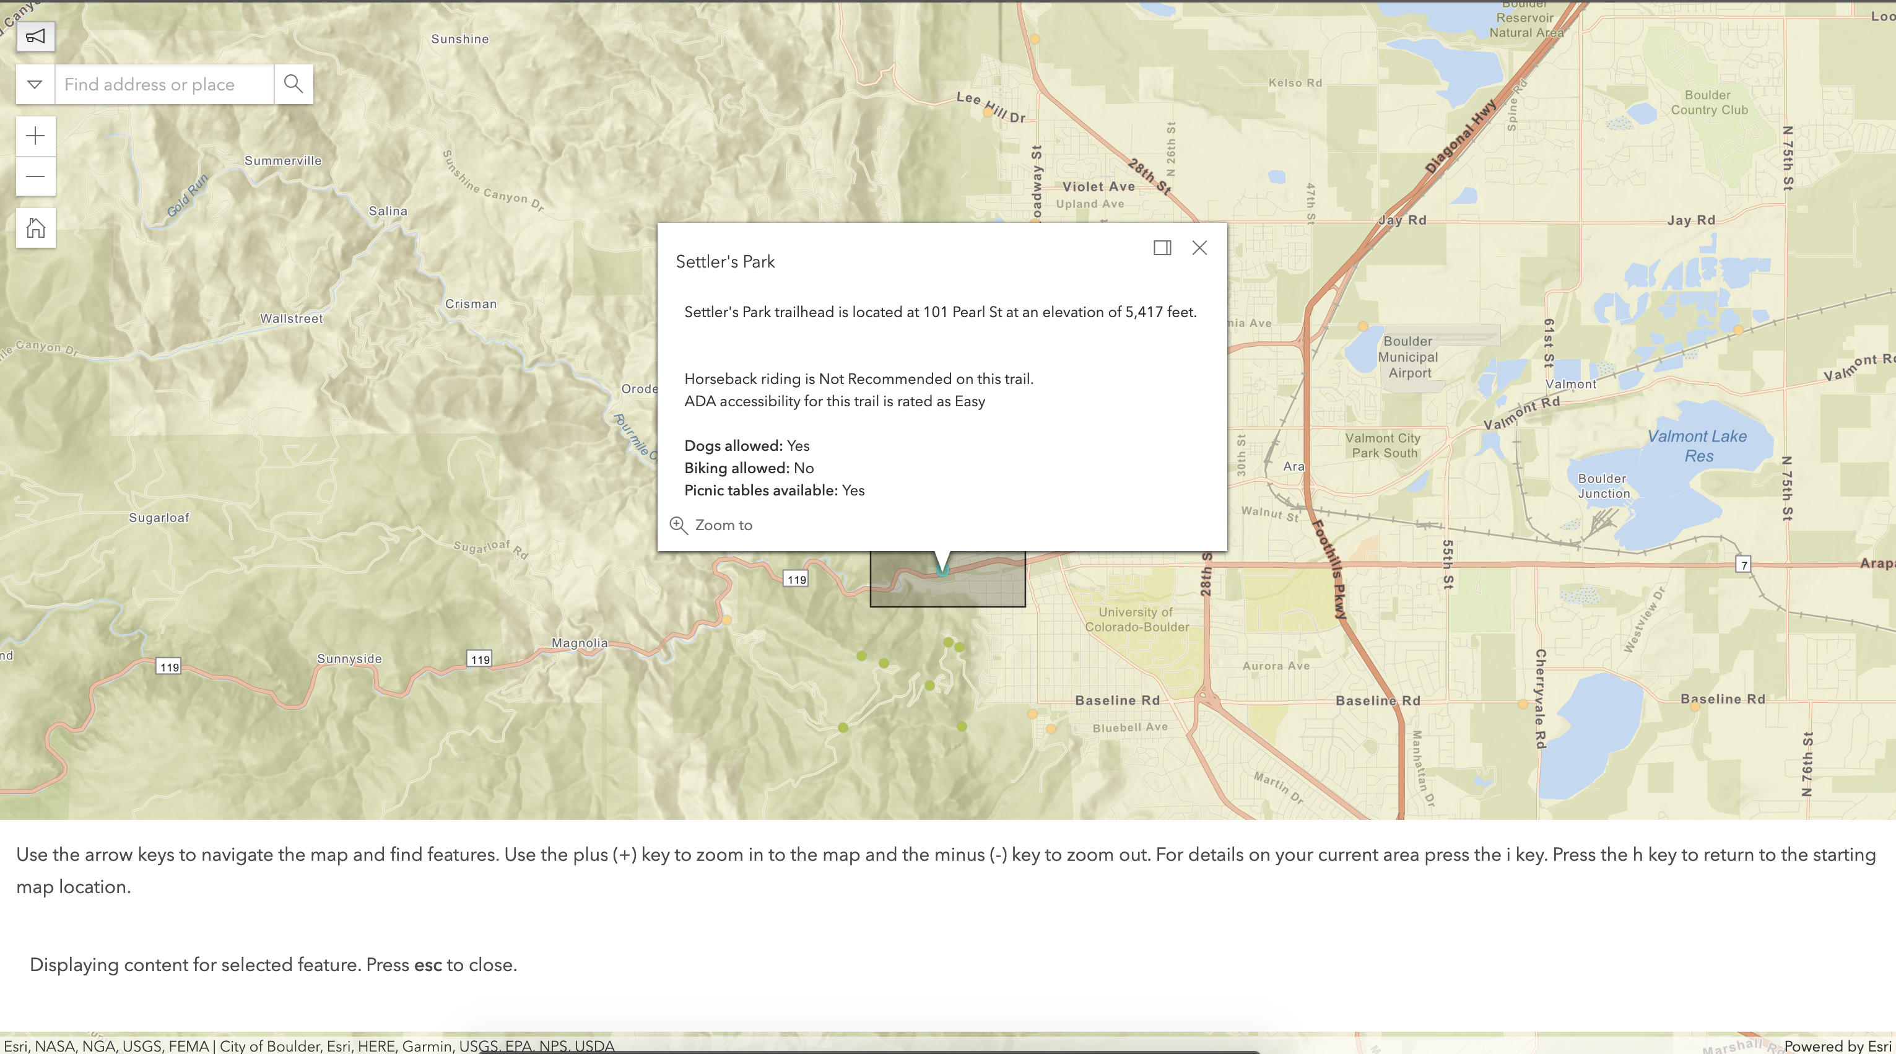
A11y map demo
Sample accessibility map
Notes:
Demo the A11y Map

Slide 12
Slides & Resources
Slides: https://github.com/nwisehart/SpeedGeeking2019
Email: nwisehart@esri.com
Resources:
W3 WCAG
https://developers.google.com/web/fundamentals/accessibility/
https://www.usability.gov/what-and-why/accessibility.html

Slide 13


Slide 14
Presentation Title
Presenter Names
2019 ESRI DEVELOPER SUMMIT
Palm Springs, CA
Notes:
G243257 DevSummit 2019 Template for Esri staff

Slide 18
Click Here For DEMO
Sample Name Here

Slide 20

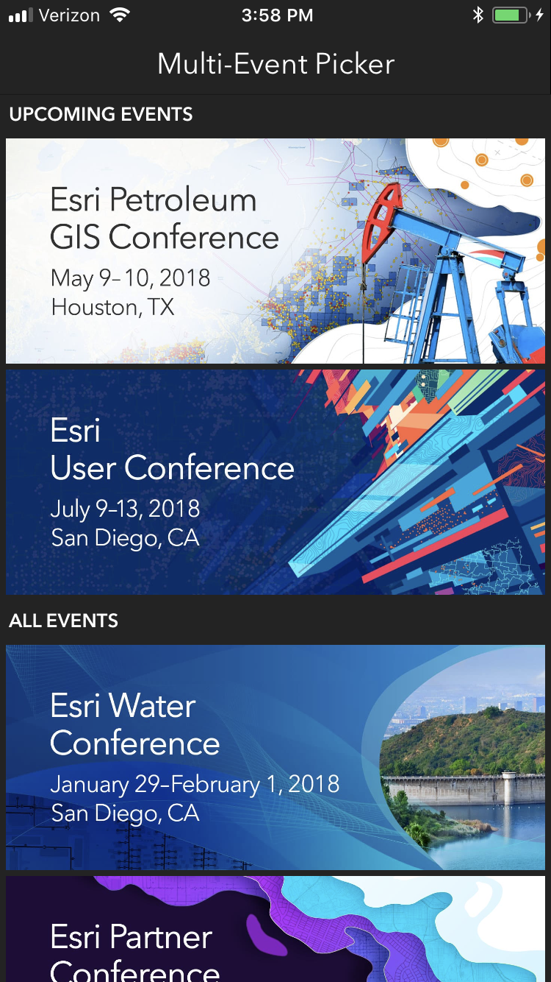
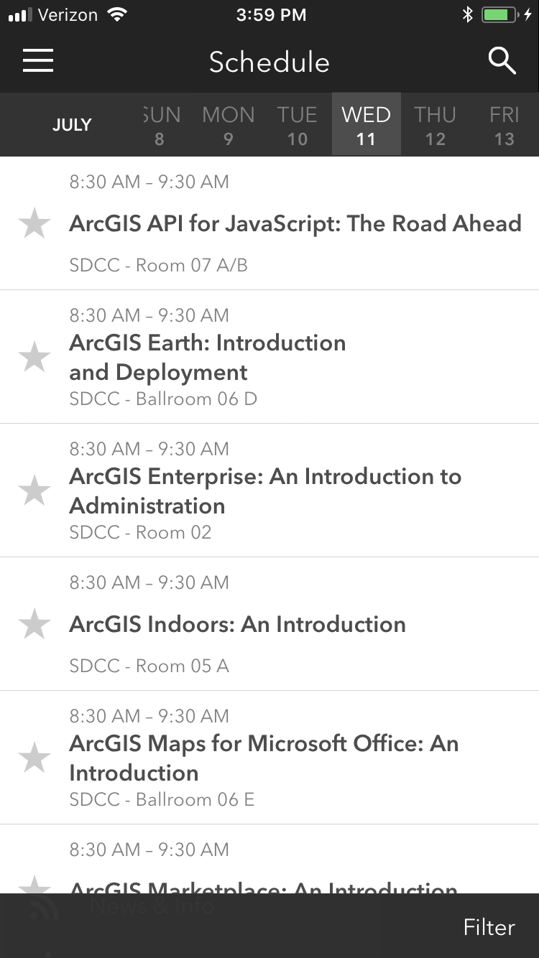
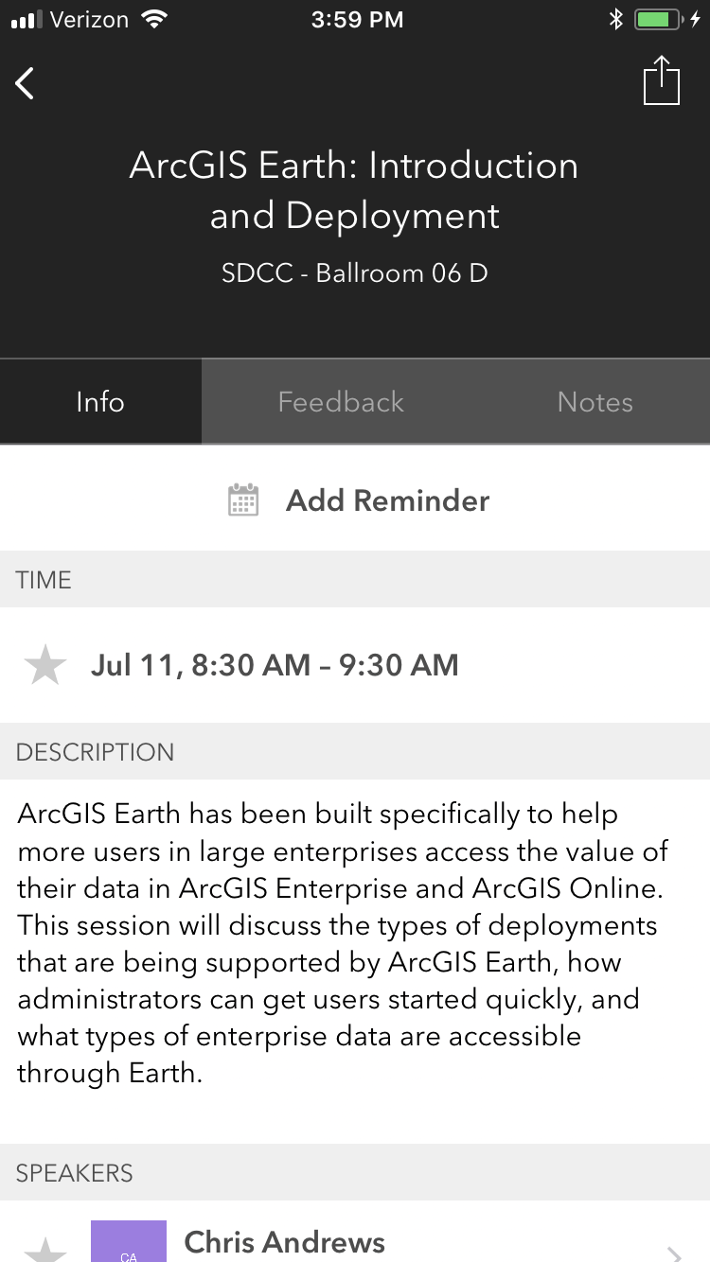
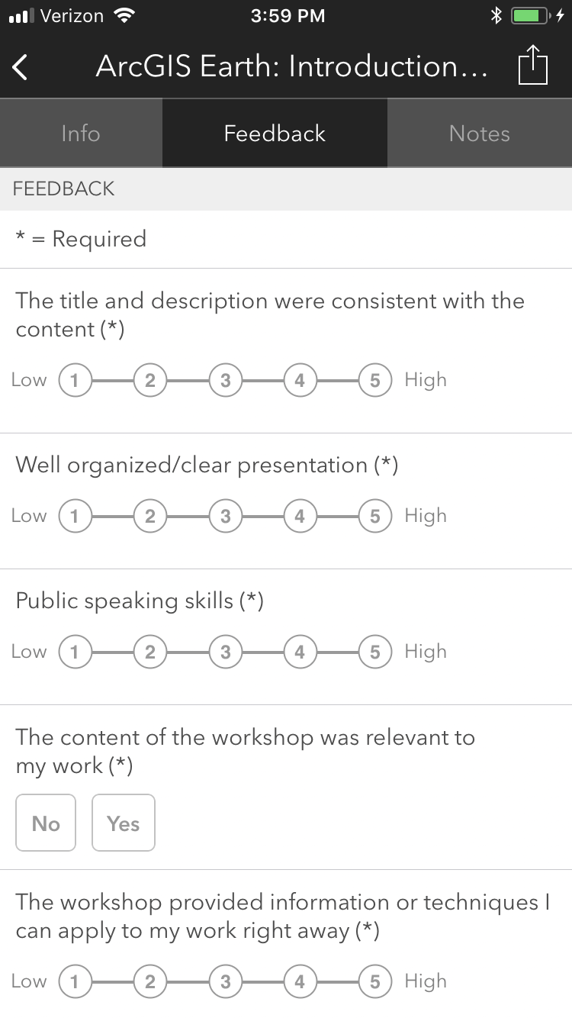
Please Take Our Survey on the App
Download the Esri Events app and find your event
Select the session you attended
Scroll down to find the feedback section
Complete answers
and select “Submit”

